Slide 1
JAVASCRIPT

Slide 2
What is java script
JavaScript is a programming language used to create dynamic content for websites. It is a lightweight, cross-platform, and single-threaded programming language. JavaScript is an interpreted language that executes code line by line providing more flexibility.
HTML adds Structure to a web page, CSS styles it and JavaScript brings it to life by allowing users to interact with elements on the page, such as actions on clicking buttons, filling out forms, and showing animations.

Slide 3
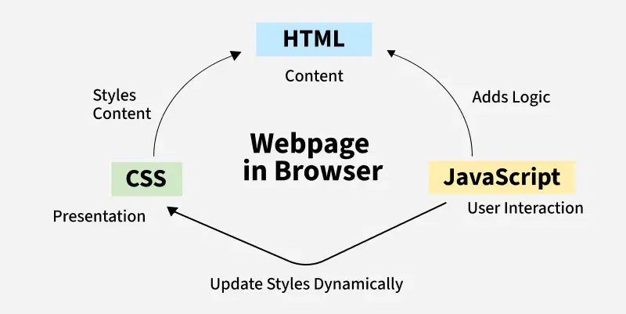

Slide 4
JavaScript Syntax:
The HTML <script> tag is used to define a client-side script (JavaScript).
The <script> element either contains script statements, or it points to an external script file through the src attribute.
Example:
<script>
…………………;
………………….;
……………………;
…………………..;
</script>
It can be Externally or Internally.
Externally using <script src=“”>

Slide 5
JavaScript Variables
A variable is like a container that holds data that can be reused or updated later in the program. In JavaScript, variables are declared using the keywords var, let, or const.
JavaScript Variables can be declared in 4 ways:
Automatically
Using var
Using let
Using const

Slide 6
The general rules for constructing names for variables:
● Names can contain letters, digits, underscores, and dollar signs.
● Names must begin with a letter, $ and _
● Names are case sensitive (y and Y are different variables).
● Reserved words (like JavaScript keywords) cannot be used as names.
A JavaScript name must begin with:
A letter (A-Z or a-z) (Ex: showmsg or Showmsg)
A dollar sign ($) (Ex: $showmsg)
Or an underscore (_) (Ex: _showmsg)
Subsequent characters may be letters, digits, underscores, or dollar signs.
Note:-
Numbers are not allowed as the first character in names.

Slide 7
Example:
x = 5; y = 6; z = x + y;
x stores the value 5
y stores the value 6
z stores the value 11
<!DOCTYPE html>
<html>
<body>
<h1>JavaScript Variables</h1>
<p>In this example, x, y, and z are variables.</p>
<p id="demo"></p>
<script>
const x = 5;
const y = 6;
const z = x + y;
document.getElementById("demo").innerHTML =
"The value of z is: " + z;
</script>
</body>
</html>
JavaScript Variables
In this example, x, y, and z are variables.
The value of z is: 11

Slide 8
Creating a variable in JavaScript is called "declaring" a variable.
Ex:- var jobName; or let jobName;
After the declaration, the variable has no value (technically it is undefined).
To assign a value to the variable, use the equal sign:
Ex: jobName = "Manager";
You can also assign a value to the variable when you declare it.
Ex: let jobName = “Manager";

Slide 9
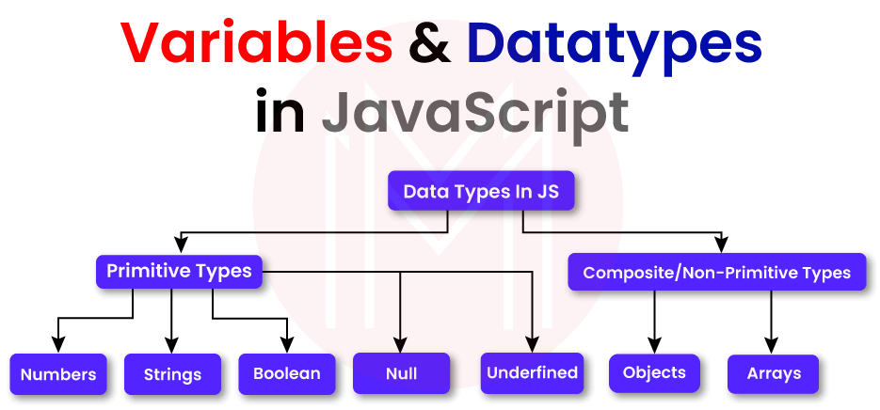
Data Types

Slide 10
Primitive datatypes represent single values and are immutable.
Non-primitive types are objects and can store collections of data or more complex entities.
Example:
1. Object: Represents key-value pairs.
let obj = { name: "Amit", age: 25 };
3. Function: Represents reusable blocks of code.
function fun() { console.log("GeeksforGeeks");
2. Array: Represents an ordered list of values.
let a = ["red", "green", "blue"];

Slide 11
Functions
• Function is like a mini-program or a set of instructions that you can create and give aname.
• It’s a way to group tasks, making your code more organized and easier to understand.
Benefits of using functions
1. Code organization
2. Reusability
3. Modularity
Function Syntax:
• Basic structure: function functionName(parameters) { ... }

Slide 12
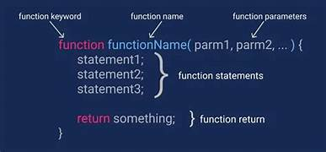
Difference Between Parameters and Arguments
Parameters refer to the variables listed in a function's declaration, defining the input that the function can accept. Arguments, however, are the actual values passed to the function when it is called, filling the parameters during execution.

Slide 13
def add(x, y): # Here, x and y are parameters return x + y
result = add(5, 3) # Here, 5 and 3 are arguments
Invoking a JavaScript Function:
The code inside a function is not executed when the function is defined.
The code inside a function is executed when the function is invoked.
It is common to use the term "call a function" instead of "invoke a function".
It is also common to say "call upon a function", "start a function", or "execute a function".
In this tutorial, we will use invoke, because a JavaScript function can be invoked without being called.

Slide 14
Example
function myFunction(a, b) { return a * b; } myFunction(10, 2); // Will return 20
Try it Yourself

